Slide 1
The Vietnamese and The Japanese understand mutual
Confidential
Only IBSV, IBSO
2014/10/27
IBS Vietnam – Dang Ngoc Duc
IBS Okinawa – Kensaku Yamane

Slide 2


Purpose of this Document and Approach
Japanese and Vietnamese understand each other.
Approach
We know that other people have image to us.
We have an imagine to others.
By understanding the difference compares the above, lead to mutual understanding.
A-san is
・Good at Java
・Productivity is high
・Make high quality
A-san is
・Good at Java
・Productivity is bit high
・But quality is bad
Match
Match?
B-san
in A-san imagine
difference
A-san
B-san

Slide 3
Note
This document is not intended to hurt each other.
By exchanging opinion honestly, it's intended to be lead to mutual understanding.
We- Yamane and Duc- apologize if you feel uncomfortable to look at this document.
Tài liệu này không dùng mục đích ám chỉ ai hoặc làm tổn thương ai.
Không đề cập đến 1 người nào cụ thể, không dùng để đại diện cho tất cả mọi người.
Bằng cách trao đổi ý kiến ​​một cách trung thực, dự định là dẫn đến mọi người sẽ hiểu nhau hơn.
Chúng tôi-Yamane và Duc- xin lỗi nếu bạn cảm thấy không thoải mái khi xem tài liệu này.
この資料はお互いを傷つけるためのものではない。
率直に意見を交わすことで、相互理解へとつなげるためのものだ。
もしこの資料を見て不快に感じたら申し訳ない。

Slide 4
Agenda
From Vietnamese To Japanese(Please, self reading)
- Japanese thinking about Vietnamese
- Japanese Engineers as viewed from the Vietnamese
2. From Japanese To Vietnamese
- Vietnamese thinking about Japanese
- Vietnamese Engineers as viewed from the Japanese
Our Thinking
Discussion (P 10, 11, 13, 31, 35, 12)

Slide 5
From Vietnam
To Japan

Slide 6
Thinking of Vietnam member
[Japanese thinking about Vietnamese]

Slide 7
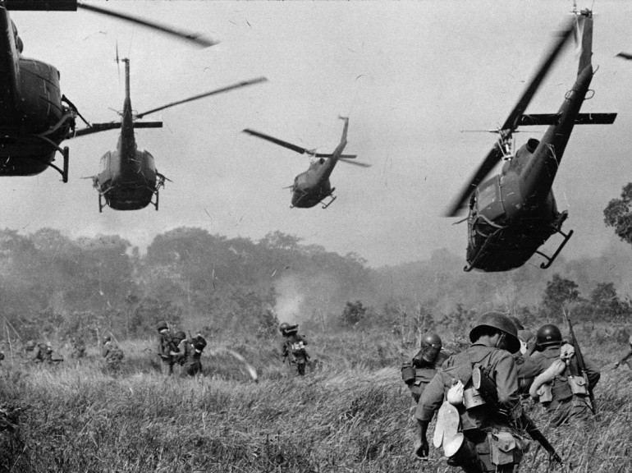
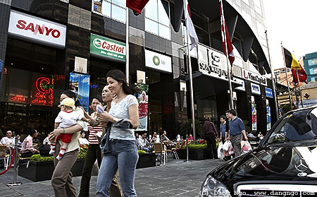
Thinking of Vietnam member Japanese thinking about Vietnam today is poor.
Vietnam is poor country and have internal war.
⇒ Vietnam had internal war for 40 years ago and now we are develop country.
Vietnamese Agree this Hypothesis
Yes | No
73% | 27%
Japanese Think like this
Yes | No
39% | 61%

Slide 8
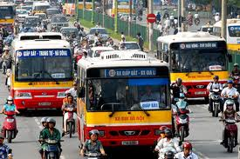
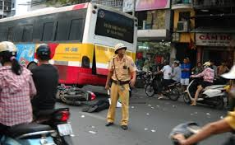
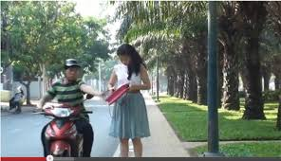
Thinking of Vietnam member Japanese thinking about Vietnam today is dangerous
Vietnam is poor public transport and dangerous for foreigner.
⇒Vietnam have not good public transport, more private motorcycles.
Have more traffic accident on the street. The foreigners can being robbed on the street.
ベトナムの交通期間は整備されていなく、外国人にとって危険だ。
事故も多い。路上で窃盗にあう。
Vietnamese Agree this Hypothesis
Yes | No
50% | 50%
Japanese Think like this
Yes | No
50% | 50%

Slide 9
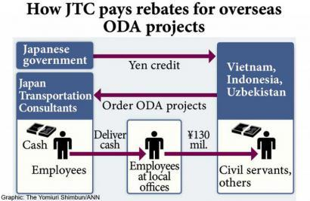
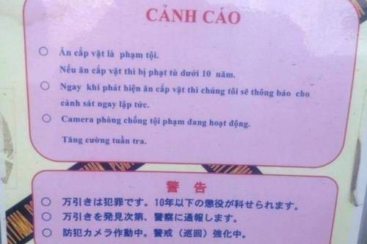
Thinking of Vietnam member Japanese thinking about Vietnamese is not believed
The few ODA projects in Vietnam is corruption.
Have warning Vietnamese at Japanese supermarket about shoplifter.
ODAのプロジェクトの中には汚職に利用されているものがある。
日本のスーパーマーケットにはベトナム語で万引きの注意書きがある。
Vietnamese Agree this Hypothesis
Yes | No
31% | 69%
Japanese Think like this
Yes | No
11% | 89%

Slide 10

Thinking of Vietnam member Japanese thinking “Vietnam member is good characteristic"
The enthusiastic characteristic.
⇒ VN member always welcome and implement tasks assigned.
ベトナムの人は熱狂的な性格だ。
ベトナムのメンバーはいつでも喜んでアサインされたタスクをこなす。
Japanese Think like this
Yes | No
6% | 94%
78% | 22%
Vietnamese Agree this Hypothesis
Yes | No
92% | 8%
Agree 1st Sentence →

Slide 11
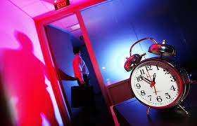
Thinking of Vietnam member Japanese thinking “Vietnam member is good responsibility"
Try to finish the task in responsible for deadline.
⇒ If the project need to work OT, VN member can work OK to kept deadline.
任せられたタスクを期限内に終わらせようとする。
必要ならば残業もする。
Vietnamese Agree this Hypothesis
Yes | No
85% | 15%
Japanese Think like this
Yes | No
39% | 61%

Slide 12
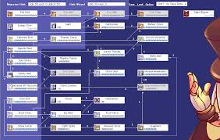
Thinking of Vietnam member Japanese thinking “Vietnam member is smart and high skills"
Vietnamese member have high skills.
⇒ VN member can resolved the complex tasks and improve the performance speed better.
ベトナムのメンバーは高い技術力を持っている。
複雑なタスクでも解決できる(パフォーマンス改善もできる)
Vietnamese Agree this Hypothesis
Yes | No
80% | 20%
Japanese Think like this
Yes | No
50% | 50%

Slide 13
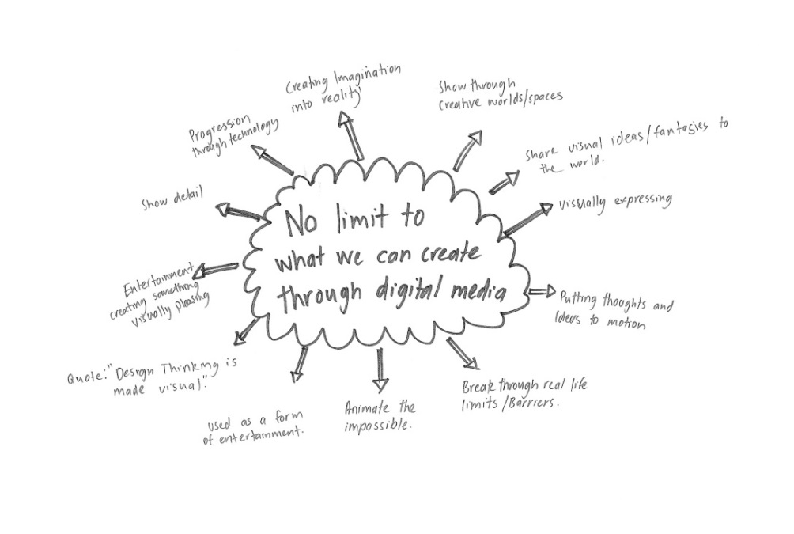
Thinking of Vietnam member Japanese thinking “Vietnam member is smart and good ideas"
Contribution ideas to improve the project.
⇒ VN member contributed the ideas and make the ideas come true on the project.
ベトナムメンバーはプロジェクトを改善するアイデアをだし、実行し貢献する
Vietnamese Agree this Hypothesis
Yes | No
77% | 23%
Japanese Think like this
Yes | No
6% | 94%

Slide 14
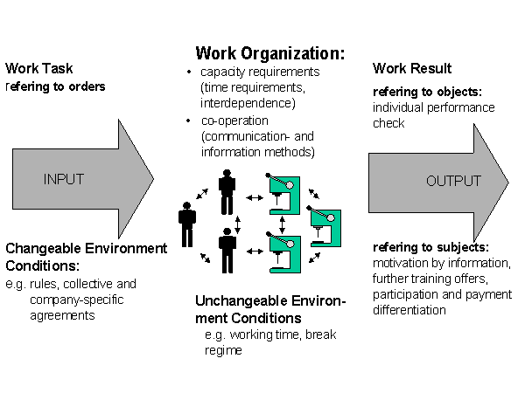
Thinking of Vietnam member Japanese thinking “Vietnam member is not punctual"
Have not appreciate about organizational work and discipline.
⇒ When project schedule is strict, some member absented and did not work for recovery.
Some member did not kept the rule of project and guideline.
組織の規律を守らないことがある。
スケジュールが厳しい状態でも休むことがあるし、リカバリしょうとしない。
Vietnamese Agree this Hypothesis
Yes | No
69% | 31%
Japanese Think like this
Yes | No
61% | 39%

Slide 15
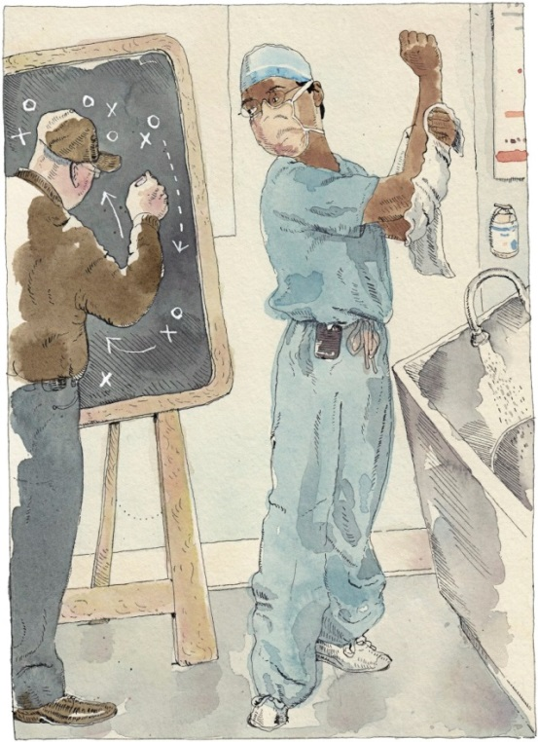
Thinking of Vietnam member Japanese thinking “Vietnam member is not suitable performance."
Vietnam member is not working hard.
⇒ VN member’s performance is not suitable with high skill. This task is easy but why VN member need more long time.
ベトナムメンバーは一生懸命働かない。
Vietnamese Agree this Hypothesis
Yes | No
15% | 85%
Japanese Think like this
Yes | No
11% | 89%
Notes:
このページわからない

Slide 16

Thinking of Vietnam member Japanese thinking “Vietnam member is not reliable"
Vietnam member is not reliable to assign importance task.
⇒ This is importance task so Japan member should implement it. VN member is not enough and do not understand to implement it.
ベトナムのメンバーは重要なタスクを任せられるほど信用できない。
重要なタスクは日本のメンバーが担当する。
Vietnamese Agree this Hypothesis
Yes | No
23% | 77%
Japanese Think like this
Yes | No
50% | 50%

Slide 17

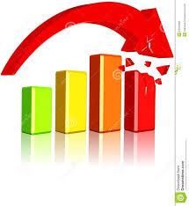
Thinking of Vietnam member Japanese thinking “Vietnam member is not careful"
Vietnam member is not careful and the quality is degrade.
⇒ Why VN member fixed this bug and another the bug occurred. Did they test all case?
ベトナムメンバーは注意深くなく時折デグレを起こす。
なんで直したのに別のバグをつくるんだろう？ちゃんとテストした？
Vietnamese Agree this Hypothesis
Yes | No
31% | 69%
Japanese Think like this
Yes | No
44% | 56%

Slide 18
Japanese
as viewed from the Vietnamese

Slide 19
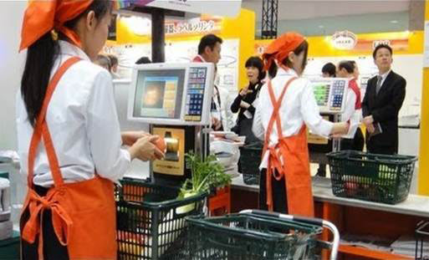
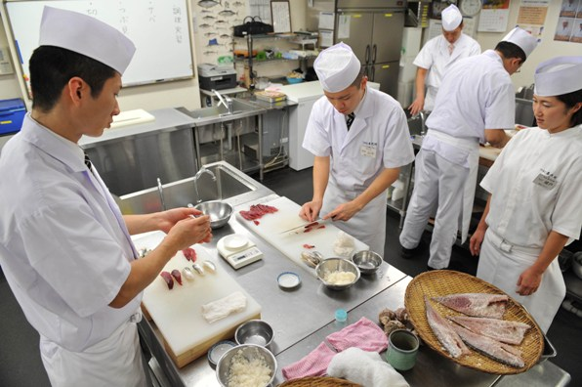
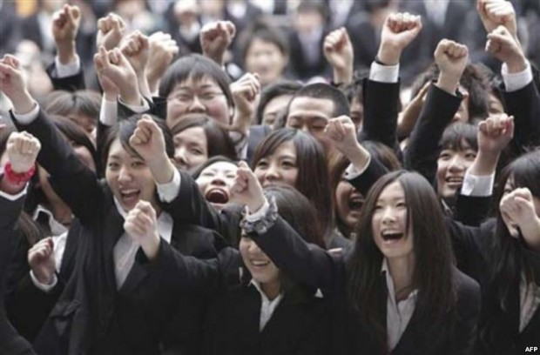
Japanese as viewed from the Vietnamese Japanese famous for the diligent and great working attitude
Japanese people famous for the diligent and great working attitude.
⇒ They work so hard and full responsibility, team work skill, high value in working.
日本人は 勤勉で働く姿勢がすばらしいと有名。
一生懸命働き、責任感もつよい。チームで働くスキルも高い。
They always return even 1yen
They have high team work skill
They always full responsibility
Vietnamese agree
Yes | No
77% | 23%

Slide 20
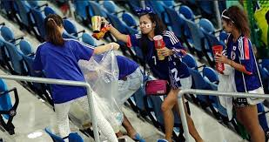
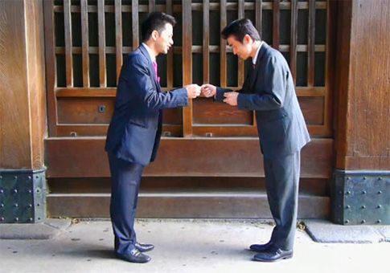
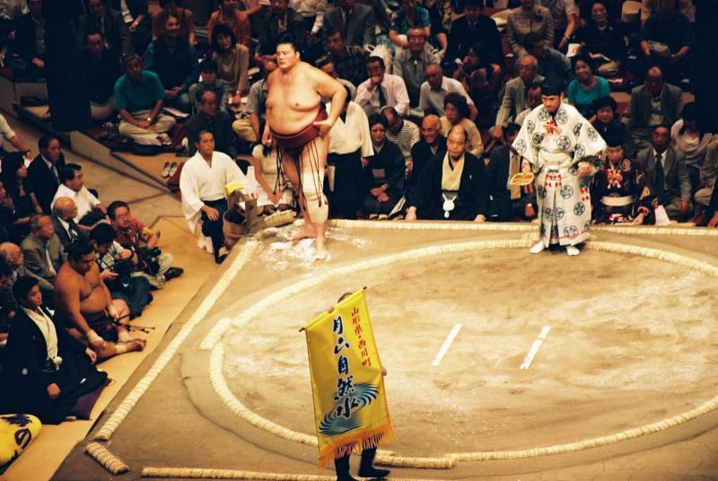
Japanese as viewed from the Vietnamese Japanese also have a good characters
They also have a good characters such as courtesy, calm mood and friendly, polite in communication
Japanese treat other people with respectfully.
日本人は性格がよく礼儀正しい。穏やかで友好的。他人に敬意を持つ。
They clean the seat after match
They always are polite in communication
They always have a Bushido spirit
Vietnamese agree
Yes | No
96% | 4%

Slide 21
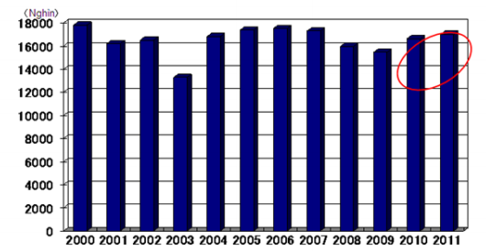
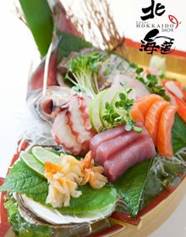
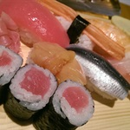
Japanese as viewed from the Vietnamese Japanese enjoy life (travel, cuisine)
Japanese enjoy life (go travel long time, made famous cuisine).
日本人は生活を楽しんでいる。長期の旅行を楽しむ。ご馳走も有名。
Japanese go outbound
(thousand persons)
Japanese made famous cuisine
Vietnamese agree
Yes | No
50% | 50%

Slide 22
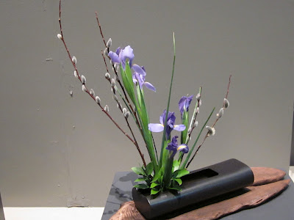
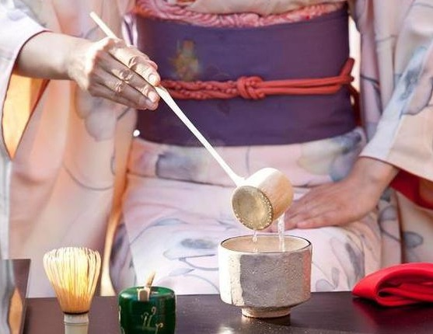
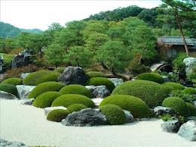
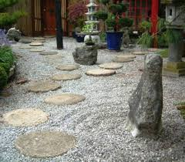
Japanese as viewed from the Vietnamese Japanese is principle and make something become religion
Japanese is principle and make something become religion(ikebana, chado, Karesansui, Chaniwa and Tsukiyama.).
Ikebana
chado
Japanese garden
Vietnamese agree
Yes | No
100% | 0
Notes:
Principleがあっていない

Slide 23
Japanese Engineers
as viewed from the Vietnamese

Slide 24


Japanese Engineers as viewed from the Vietnamese "Do not answer yes or no clearly" or "always consult with supervisor“
Japanese Engineers is waiting long time to decision.
And take more time to confirm what understand or not
⇒ Vietnam member can not understand why it took long time. The waiting time is waste time.
日本のエンジニアは決定まで長く待つ。
何かわかるかどうか確認するのに時間がかかる。
ベトナムから見ると何故そんなに時間がかかるのか理解できない。
時間の無駄じゃない？
Vietnamese agree
Yes | No
54% | 46%

Slide 25


Japanese Engineers as viewed from the Vietnamese Japanese people always respect the work environment
Japanese Engineers is not talking when working, the face look serious.
⇒ Vietnam member think he is not friendly and not closely.
日本のエンジニアは仕事中話さない。表情はいつも真剣。
ベトナムのメンバーは友好的じゃない、身近じゃないように感じている
Vietnamese agree
Yes | No
100% | 0

Slide 26

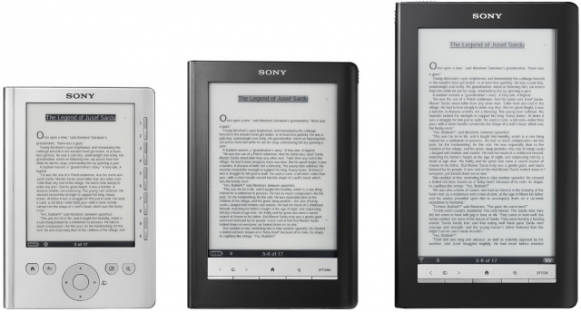
Japanese Engineers as viewed from the Vietnamese Japanese people always read paper books
Japanese Engineers read paper book to teach himself.
⇒ Vietnam member think why he did not read e-book, it is cheaper and more easily to search.
日本のエンジニアはいつも紙の本をみて学習している。
何故電子書籍にしないのか、安いし検索もできるのに。
Vietnamese agree
Yes | No
38% | 62%

Slide 27
From Japan

Slide 28
Thinking of Japanese member
[Vietnamese thinking about Japanese]

Slide 29
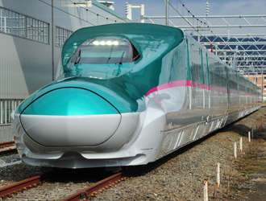
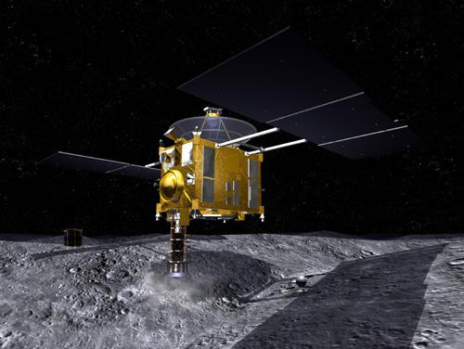
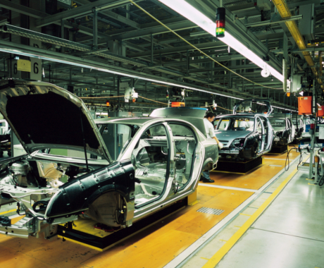
Thinking of Japanese member Vietnamese thinking Japanese have high skills.
Japanese have a high technology
日本人は高い技術力を持っている。
Japanese Agree this Hypothesis
Yes | No
83% | 17%
Vietnamese Think like this
Yes | No
54% | 46%

Slide 30

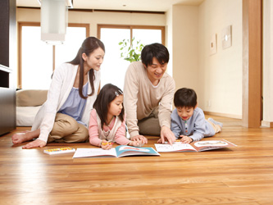
Thinking of Japanese member Vietnamese thinking Japanese work a lot.
Japanese works well. Physical and Mental condition are okay?
Time with the family suspect that the missing.
日本人はよく働く。体調大丈夫？
家族との時間が不足しているのでは？
Japanese Agree this Hypothesis
Yes | No
100% | 0
Vietnamese Think like this
Yes | No
100% | 0

Slide 31
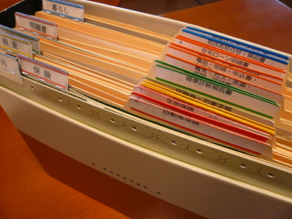
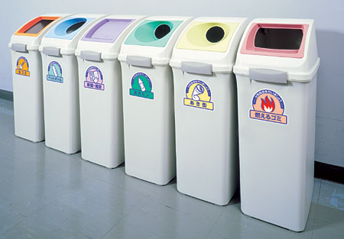
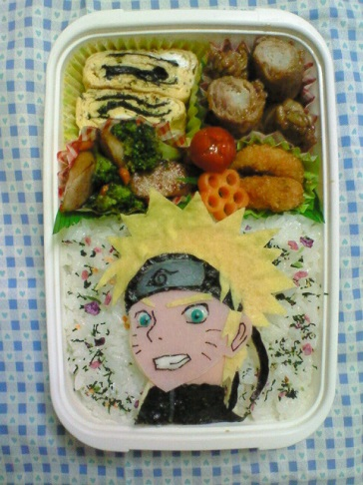
Thinking of Japanese member Vietnamese thinking Japanese are too fine people.
Japanese stick to details.
Japanese is particular about the details.
日本人は細かすぎる。細部にこだわる。
Japanese Agree this Hypothesis
Yes | No
100% | 0
Vietnamese Think like this
Yes | No
50% | 50%

Slide 32
Thinking of Japanese member Vietnamese thinking Japanese are is not me enough explanation.
Japanese is not me enough explanation.
Therefore, Vietnamese sometimes troubled.
日本人は十分に説明しない。
そのため、ベトナム人は時々困っている。
Please do this task. Deadline is tomorrow.
(He didn’t what this task for?)
I want you to add one item to the screen.
(He didn’t why customer need the item?)
Japanese
Japanese Agree this Hypothesis
Yes | No
83% | 17%
Vietnamese Think like this
Yes | No
46% | 54%

Slide 33
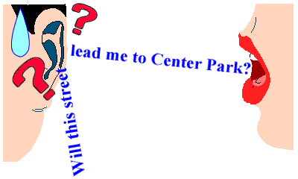
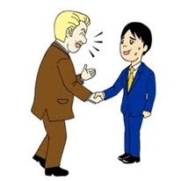
Thinking of Japanese member Vietnamese thinking Japanese are not good at English.
Japanese are not good at English.
日本人は英語が得意でない。
Japanese Agree this Hypothesis
Yes | No
83% | 17%
Vietnamese Think like this
Yes | No
88% | 12%

Slide 34
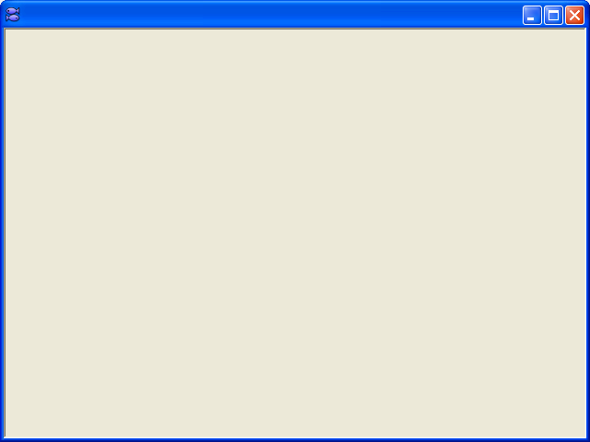
Thinking of Japanese member Vietnamese thinking Japanese cram functions on one screen
There are many features on the screen.
Japanese are greedy about features.
1つの画面にたくさんの機能をつめこむ。機能についてはよくばりだ。
Search
List
sort
edit
Like Excel UI
custom
validation
Too many items
delete
Japanese Agree this Hypothesis
Yes | No
56% | 44%
Vietnamese Think like this
Yes | No
23% | 77%

Slide 35
Thinking of Japanese member Vietnamese thinking Japanese are negative.
Some Japanese speaks ill of oneself.
Japanese tends to underestimate their own ability.
Japanese own evaluation is low.
日本人は自分のことを悪くいう。自己評価が低い。
Sorry, it’s my mistake. Sorry.
Sorry, it cause my poor document.
Japanese
Japanese Agree this Hypothesis
Yes | No
56% | 44%
Vietnamese Think like this
Yes | No
4% | 96%

Slide 36
Vietnamese Engineers as viewed from the Japanese

Slide 37

Thinking of Japanese member Productivity of the Vietnamese is higher than expected
Some Vietnamese is higher Productivity , especially in coding, than some Japanese.
ベトナム人の中には生産性、特にコーディングにおいて、が日本人より高い人がいる
Japanese agree
Yes | No
94% | 6%

Slide 38
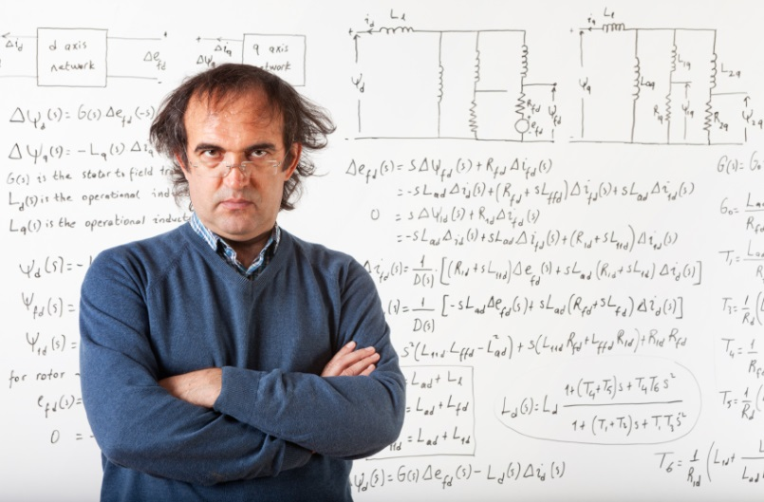
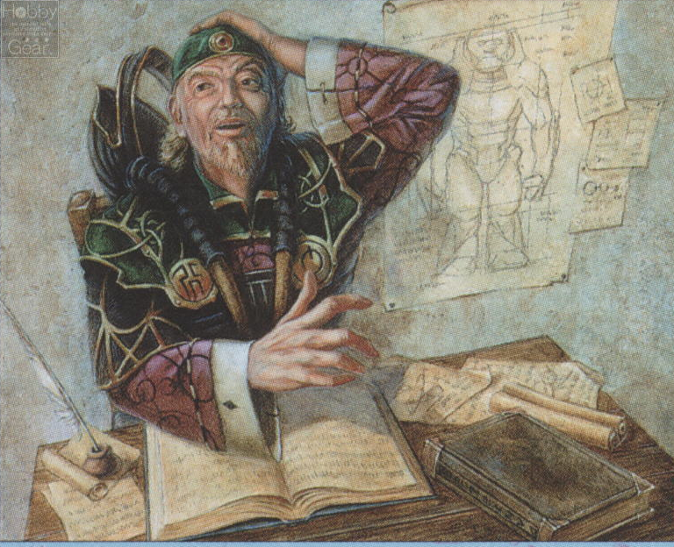
Thinking of Japanese member Skill of the Vietnamese is higher than expected
Understanding of the source is quickly.
You can also be implemented with a complex specifications in coding.
ソースを早く理解できる。複雑な仕様でも実装できる。
Japanese agree
Yes | No
72% | 28%

Slide 39


Thinking of Japanese member Confirmation is not enough
Productivity is high, but sometime there are a lot of error or mistake.
Review of their own is insufficient .
生産性は高いが、障害やミスが多い。セルフチェックが不足している。
Japanese agree
Yes | No
72% | 28%

Slide 40

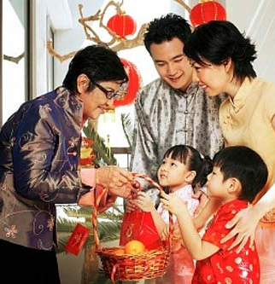
Thinking of Japanese member Vietnamese takes good care of a family
The Vietnamese takes good care of a family.
ベトナム人は家族を大事にする。
Japanese agree
Yes | No
94% | 6%

Slide 41
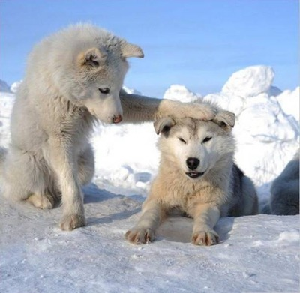
Thinking of Japanese member Seniority culture
Vietnam is culture of the seniority.
You hesitate about offering a help to an older person.
ベトナムは年功序列の社会だ。年長者に対して手伝いを申し出ることをためらう。
Japanese agree
Yes | No
38% | 61%

Slide 42
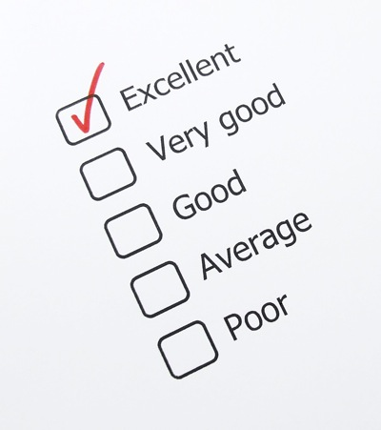
Thinking of Japanese member The source that you create is perfect.
You believe that there is no bug in the source that you create.
自分が実装したところにはバグがないと信じている。
Japanese agree
Yes | No
22% | 78%

Slide 43

Thinking of Japanese member Vietnamese is proud
The Vietnamese tends to be self-respecting.
Sometime you say “understand” when you don’t understand.
ベトナム人は自尊心が高い傾向がある。
時々わかってないのに「わかっている」ということがある。
Japanese agree
Yes | No
56% | 44%

Slide 44


Thinking of Japanese member Test and Design
Don’t you like make design document, do you?
Don’t you like more test, do you?
設計書を書くの嫌いでしょ？テストはもっと嫌いでしょ？
Japanese agree
Yes | No
50% | 50%

Slide 45
Our Thinking

Slide 46
Find difference?
Did you find difference?
If recognition is different, it produces many issues and problems.
Then how should we make an action?
A-san is
・Good at Java
・Productivity is high
・Make high quality
A-san is
・Good at Java
・Productivity is bit high
・But quality is bad
Match
Match?
B-san
in A-san imagine
difference!
A-san
B-san
Notes:
ギャップは見つかりましたか？
認識が違っている場合、課題や問題を引き起こします。
ではどうすべきでしょうか？

Slide 47

Suggestion
Let's exchange more opinions.
Let's feed back more.
Let's understand each other more.
Let's think about “How we can do it together”.
We are one team.
Notes:
もっと意見を交わしましょう。
もっとフィーバックをしましょう。
もっとお互いを理解しましょう。
「どうやればできるか？」を一緒に考えましょう。
私達は1つのチームです。

Slide 48

Message
A challenge is necessary to grow up.
Let’s challenge new things.
We grow up together, and let's become the best
Global Team!
Notes:
成長するためには挑戦が必要です。
日本人も挑戦していきます。
一緒に成長していき、最高のグローバルチームになりましょう！

Slide 49

Okinawa and Vietnam
Thank you.

